Slide 1



COURSE NAME : Data science fundamentals program
PROJECT TITLE : Bitcoin price prediction
PROJECT SUBMITTED TO : Anna University \ Naan Mudhalvan \ IBM
YEAR : 3rd year
BRANCH\DEPARTMENT : B.E. Mechanical Engineering
SEMESTER : 6th
PROJECT SUBMITTED BY : M.Giri

Slide 2







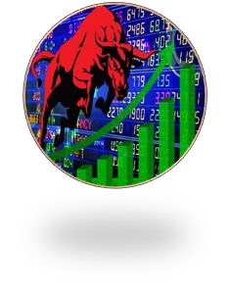





PREDICTIVE ANALYTICS
IS FOR
INTELLECTUALS
REAL ESTATE
SHARE MARKET
INSURANCE
ANDROID

Slide 3
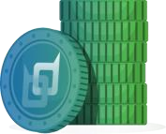

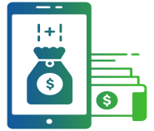


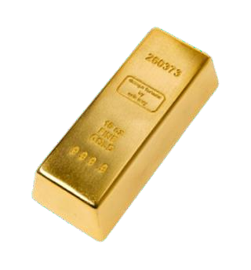




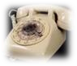
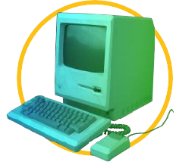


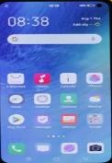

EVOLUTION OF MONEY & TECHNOLOGY
CRYPTO CURRENCY
ELECTRONIC MONEY
PAPER MONEY
PLASTICS CARDS
METAL COINS
GOLD
BARTER
RADIO
TELEPHONE
COMPUTER
INTERNET
SMART PHONE
BLOCKCHAIN

Slide 4


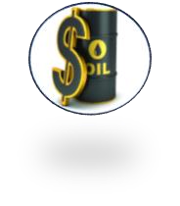
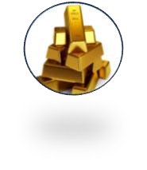
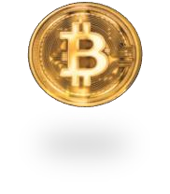


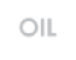

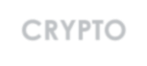






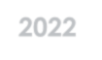


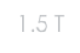


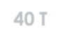

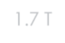



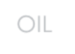
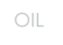
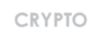
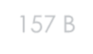




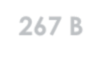




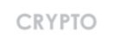
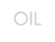
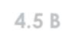


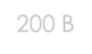

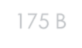






GLOBAL INDUSTRY ANALYST
PREDICTIVE
ANALYTICS
OIL
GOLD CRYPTO
2019 - VOLUME
1.7 T-$
OIL
2015 - VOLUME
1.5 T-$
OIL
2022 - VOLUME
40 T-$
CRYPTO
157 B-$
267 B-$
2 T-$
GOLD
CRYPTO
OIL
4.5 B-$
175 B-$
200 B-$
CRYPTO
GOLD
GOLD

Slide 5
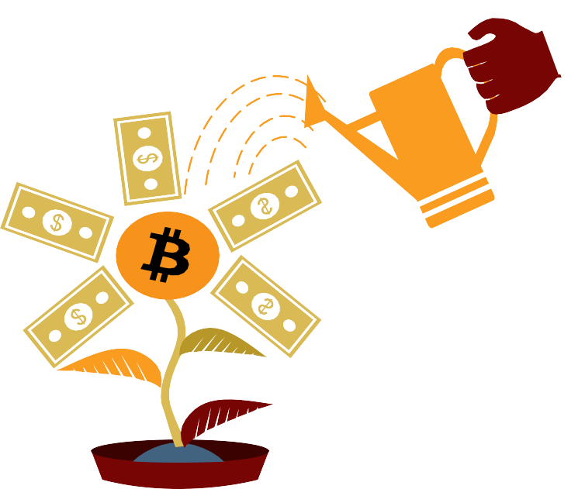


Most Profitable Investments of 2020 – BUSINESS TODAY
YTD Returns (%)
Crypto
475.5%
Silver
Gold Sensex
Nifty
45.4%
27.7%
15.5%
14.6%
Mutual Fund
8%
Fixed Deposit 6.1%
Real Estate 1.6%

Slide 6
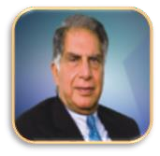

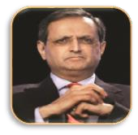

GOOGLE SAYS…
BILLIONAIRES IN CRYPTO …
Mr. RATAN TATA
TATA
Mr. AMITAB BACHCHAN
ACTOR
Mr. RICHARD BRANSON
VIRGIN GROUP
Mr.VIKRAM PANDIT
Ex CITY GROUP CEO
Mr. BILL GATES
MICROSOFT
Mr. JOHN DAVID
McFee ANTIVIRUS

Slide 7
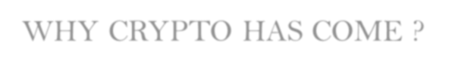







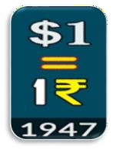
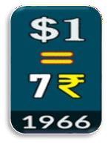
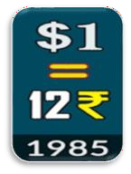
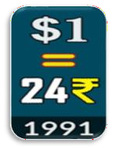
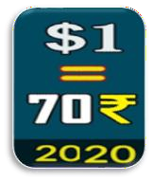














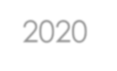

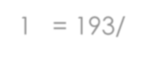






WHY CRYPTO HAS COME ?
INFLATION*
INDIA - ₹
JAPAN – YEN
AMERICA - $
CHINA - YUAN
1 WORLD – 1 CURRENCY
Mr. SATHOSHI NAKAMOTO
NOTE:
2020 – 1₹ = 193/- INDONESIA
SOMALIA ?
BITCOIN

Slide 8
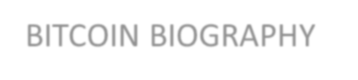

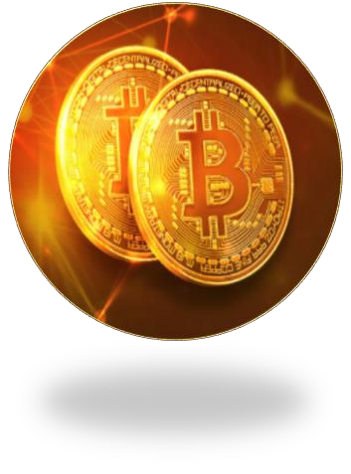




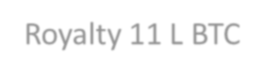
BITCOIN BIOGRAPHY
MOTHER CRYPTO BITCOIN
LAUNCH 2008
FOUNDER Mr. SATHOSHI NAKAMOTO
COUNTRY JAPAN
SUPPLY
21 MILLION (2.1 CRORES)
Royalty 11 L BTC

Slide 9

















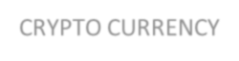

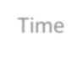
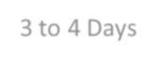

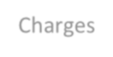
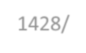
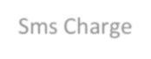

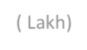
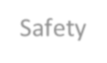
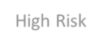
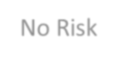













THINGS TO KNOW ABOUT CRYPTO!
1.What is Crypto ?
It is a Virtual Currency ,we can’t feel & using Blockchain
1
1
2
3
3
4
2
4
5
B
B
B
B
B
2.What are the benefits of Crypto ?
7.5L
DESCRIPTION | FIAT CURRENCY | CRYPTO CURRENCY
Time | 3 to 4 Days | Same Day
Charges | 1428/- ( Lakh) | Sms Charge
Safety | High Risk | No Risk
Value | Decrease | Increase
Control | 3rd Party | No 3rd Party
3.Why we need to know Crypto ?
When ever the new technologies coming , suggest you to travel it.

Slide 10


Crypto Currency is Legal in the Following Countries.

Slide 11





Crypto ATMs All Over The Countries

Slide 12






















HOW INDIA SUPPORT CRYPTRO ?
In a World ,Normally Crypto is used for Digital Asset as well as Tender Currency.
But In India ,we can use it for only Digital asset .
INDIA HAS SOME AUTHORIZED CRYPTO EXCHANGES :
*BITBNS *LOCAL BITCOIN *WAZIRX
*ZEBPAY *GIOTTUS *COINDCX
*BITCOIVA *BUYUCOIN
(24*7 / 365 days)
Crypto-& Bal Shakti Puraskar Award – PRIME MINISTER
Crypto is added in +2 Syllabus. > TCS Launched Crypto Services .

Slide 13




MSME
BLOCKCHAIN FUNCTIONAL & CRYPTO CURRENCY

Slide 14


Blockchain Implementations in India
HARYANA
PUNJAB
RAJASTHAN
MADHYA PRADESH
GUJARAT
UTTAR PRADESH
MAHARASHTRA
WEST BENGAL
KARNATAKA
ASSAM
ODISSA TELANGANA
KERALA
ANDHRA
TAMIL NADU

Slide 15


Bitcoin Price
YEAR
PRICE
2008
2010
2011
2016
2022
0.40
2.40
1,364
60,000
17LAKHS
*If you invest Rs.1,000/- in Bitcoin
on 2010, Now its value is around
400 Crores +

Slide 16









BELDEX
Based on Bitcoin ,
As of now approx. 10782 Cryptos are there in the market.
Price : 5 /-

Slide 17

















BELDEX BIOGRAPHY
Tokenomics
CRYPTO BELDEX
LAUNCH 2018
EXCHANGE LISTING 2019 PROMOTER GCC HUB
COUNTRY HONGKONG
60%
10%
20%
Pre & Public Sale Bounty & Airdrop
Team & Advisors
10%
Reserved Tokens
SUPPLY
990 CRORES
(Total Supply – 9.90B)

Slide 18






DESCRIPTION
WHY BELDEX ?
BITCOIN
BELDEX
Launch |  | 2008 |  | 2018
Price |  | 17 Lakhs |  | 5/-
Transaction Fee |  | Up to 3 $ |  | 0.001$
Technology |  | Open Source |  | Privacy & A.I
Transaction Time |  | ½ hr. to 1 day |  | Lightening Speed
Utility |  | No |  | Yes
Blocks |  | 7,58,156 |  | 16,14,877
Generation |  | 2G |  | 5G
Own Exchange |  | No |  | Yes

Slide 19


CRYPTO HISTORY(1LAKH COINS) 2010
CRYPTOS
PRICE INVESTMENT
PERIODS
CUR PRICE
CUR VALUE
BITCOIN | 2.40/- | 2.4 LAKHS | 12 YEARS |  | 17 LAKHS |  | 17000 CR
LITECOIN | 5/- | 5 LAKHS | 9 YEARS |  | 12,005/- |  | 120 CR
ETHEREUM | 18/- | 18 LAKHS | 6 YEARS |  | 3,04,908 |  | 3049 CR
MONERO | 40/- | 40 LAKHS | 6 YEARS |  | 15,526/- |  | 155 CR
BINANCE | 6/- | 6 LAKHS | 4 YEARS |  | 41,652/- |  | 416 CR
BELDEX |  | 5 LAKHS |  |  |  |  | ? CR
 |  |  |  | ? |  | 5/-

Slide 20






Main Features of Beldex :
BEST CRYPTO
COMMUNITY AWARD
AML
CERTIFICATION
SHARIAH CERTIFICATION
REGISTRATION CERTIFICATION

Slide 21




INDIAN EXCHANGES INR to BELDEX
INTERNATIONAL EXCHANGES BELDEX to BITCOIN

Slide 22


3
OPTIONS
1
If u want ,you buy BELDEX through EXCHANGE
and hold it.
2
If u want , you deposit the BELDEX with GCC HUB &
get some benefits.
3
If u want , you can also do BELDEX as a BUSINESS.

Slide 23


GLOBAL CRYPľO COMMUNIľY HUB
Belcrypto Global Exchange HK Ltd 9/F, Silver Cord Twr2,
Causeway Bay, Hong Kong (REG NO- 2174473)

Slide 24






FRANCHISE
AFFILIATE
+
GET UNLIMITED INCOME

Slide 25



for Joining Us…
Be Happy…

